Slide 1
R Clinic
Session 4:
ANOVAs, t-tests and regressions

Slide 2
REMINDER: write down your email address for access to the Dropbox with slides and code.
We will be in this room until beginning of August

Slide 3
Aim of snippet sessions
A brief overview of a topic in R
A quick refresher
Provide a ‘jumping off point’ to get you started in a new area of R coding – not statistical guidance
Suggestions welcome!

Slide 4
Intro to simple statistical tests
3 basic tests
Use depends on type of data
Model assumptions should not be broken

Slide 5
What are we asking?
Is there a difference between this thing and this other thing?
t-test
Is there a difference between all these different things?
ANOVA
Is there a relationship between this thing and this other thing?
Regression

Slide 6
Explanatory
 | Continuous | Categorical | Both
Continuous | Regression | ANOVA | ANCOVA
Count | Log-linear models | Analysis of deviance | Analysis of deviance
Proportion | Logistic regression
Response

Slide 7
T-tests
t.test(x)
Compare 2 means
Means are independent, variances are constant, errors normally distributed

Slide 8
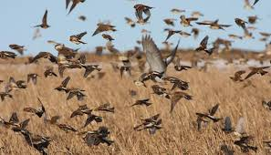
One sample t-test
Farm with 10 hedgerows
Previous surveys show a mean of 2 birds per hedge
Landowner plants wild bird cover
Is the new count different from the previous mean?

Slide 9
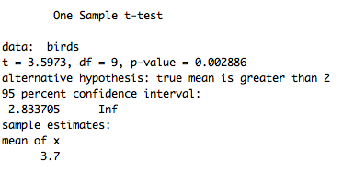
New count of birds
T-test
Output

Slide 10

Two sample t-test
Two categories of people
Breakfast eaters
Non-breakfast eaters
Count the number of biscuits eaten at coffee morning
Do those who eat breakfast scoff fewer biscuits than the non-breakfast eaters?
Image :http://hyperboleandahalf.blogspot.co.uk/2010/10/god-of-cake.html

Slide 11

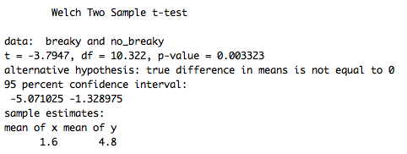
Two categories of people, and biscuits eaten
T-test function
Output

Slide 12
If want to compare more than 2 categories.....use ANOVA (Analysis of variance)

Slide 13
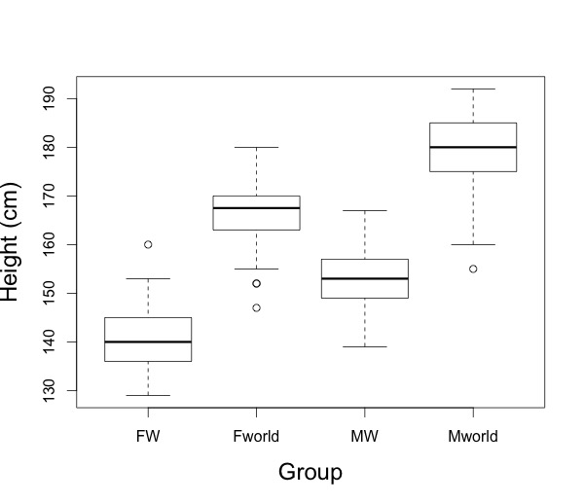
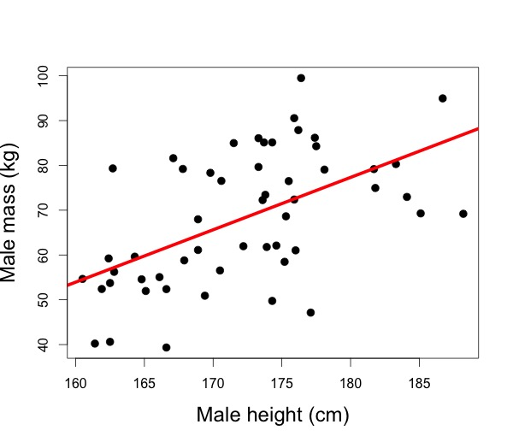
Using regression and ANOVA
ANOVA
Variance explained by a categorical variable
Regression
Variance explained by a continuous variable

Slide 14
Model Assumptions
ANOVA assumptions
Linear model assumptions
random sampling
equal variances
independence of errors
normal distribution of errors
additivity of treatment effects
explanatory variable measured without error
errors normally distributed
variances are constant
all of the unexplained variation is confined to the response variable

Slide 15
ANOVA - Analysis of Variance
Compare 3 or more means
Use iris dataset
Compare means of petal length between 3 species

Slide 16

ANOVA - Analysis of Variance
Compare 3 or more means
Use iris dataset
Compare means of petal length between 3 species

Slide 17

ANOVA - Analysis of Variance
Compare 3 or more means
Use iris dataset
Compare means of petal length between 3 species

Slide 18
aov() output
summary(one.way)
summary.lm(one.way)
model.tables(one.way, 'means', se=TRUE)

Slide 19
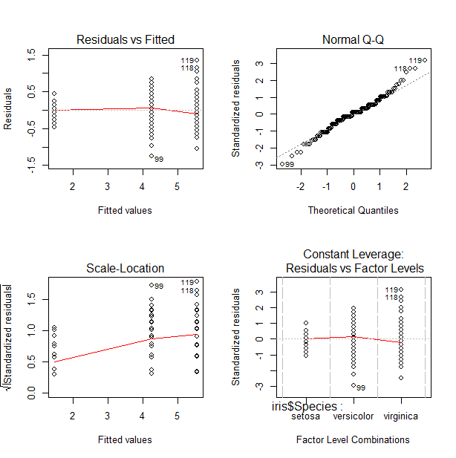
Model checking
plot(one.way)
Produces
diagnostic plots
Important to
know if model is
breaking
assumptions

Slide 20
Regression
Predict the values of y (dependent response variable),
from the values of x (independent predictor variable)
Tests the Null hypothesis that the value of y does not depend on the value of x.

Slide 21
Regression using linear model
See if and how petal length varies with sepal length
Null hypothesis = petal length is independent of sepal length

Slide 22
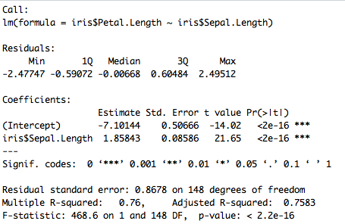

Slide 23
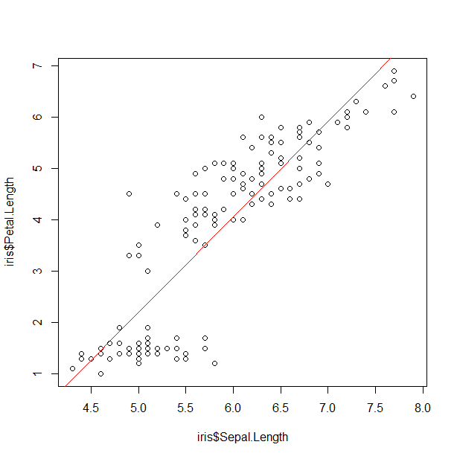

Plot to see relationship

Slide 24
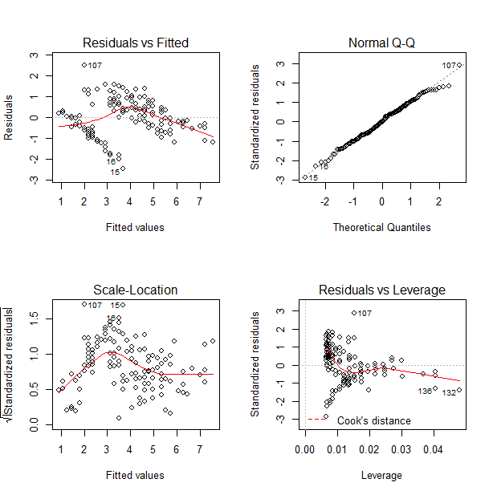
Model checking

Slide 25
Summary
t test compares means - t.test()
ANOVA analysis of variance - aov()
regressions using lm()
bad model= untrustworthy results

Slide 26
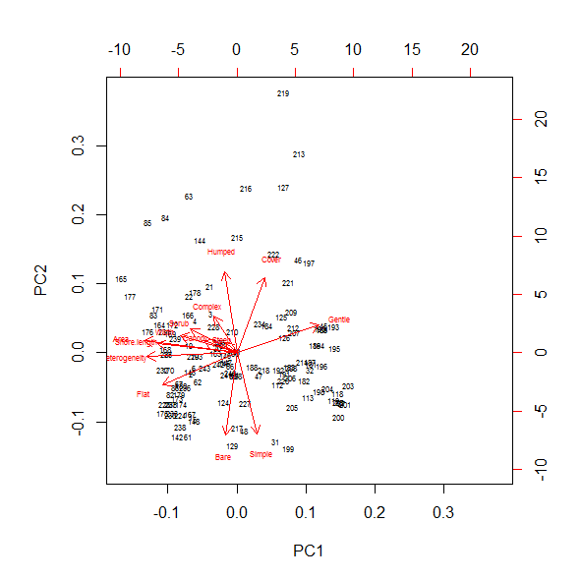
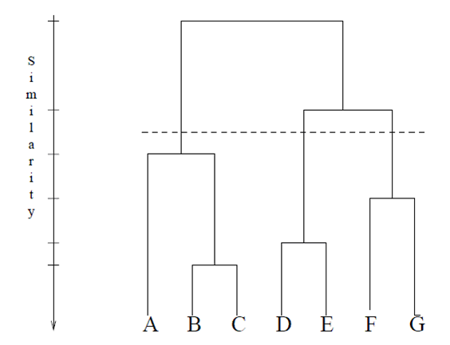
Next time…
An introduction to multivariate statistics

